Slide 1
Session 12
Bit Manipulation and Time Complexity

Slide 2
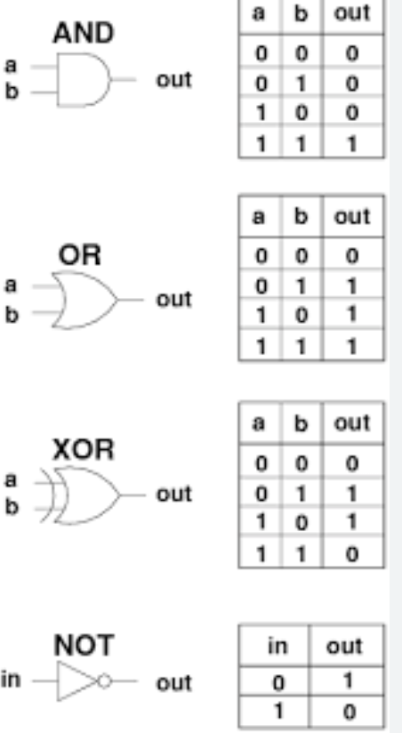
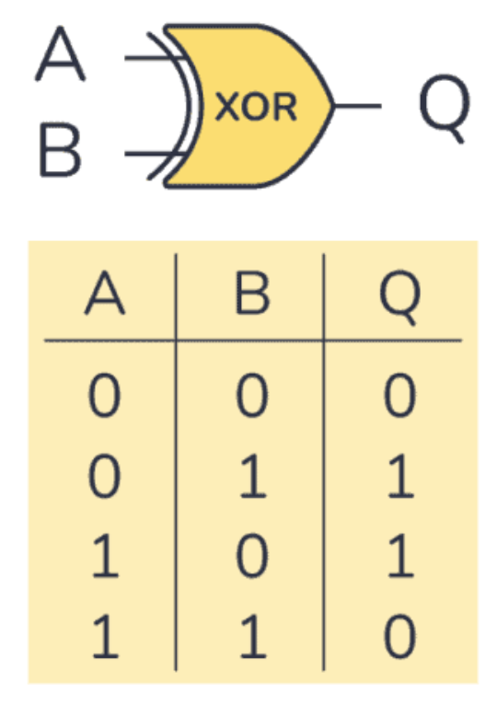
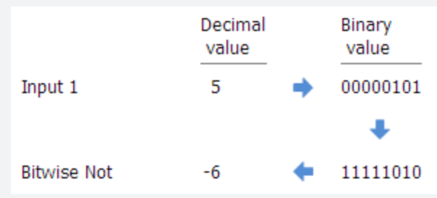
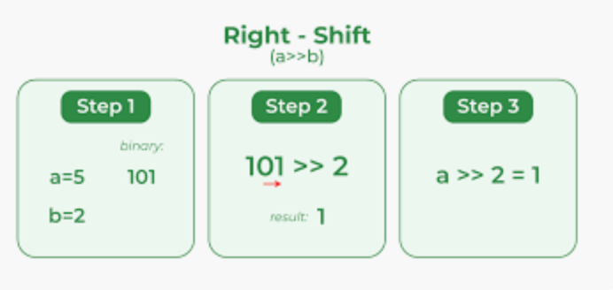
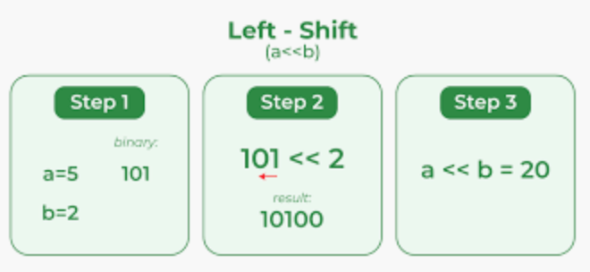
Introduction to Bit Manipulation
- Understanding binary representation.
- Basics of bitwise operators:
AND, OR, XOR, NOT, left shift, right shift.

Slide 3
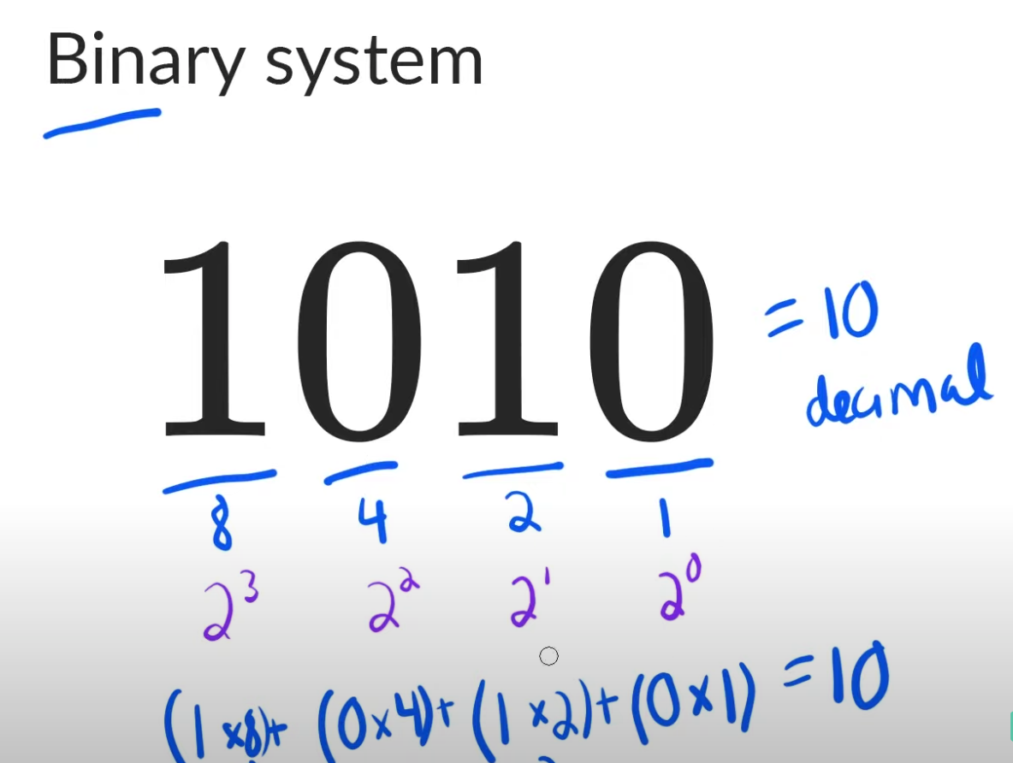
Bitwise Operators and Their Use Cases
1. AND (`&`) 2. OR (`|`) 3. XOR (`^`) 4. NOT (`~`) 5. Left Shift (`<<`) 6. Right Shift (`>>`)
7. Unsigned Right Shift (`>>>`)

Slide 4
Bit Manipulation Techniques
1. Setting a Bit 2. Clearing a Bit 3. Toggling a Bit 4. Checking if a Bit is Set
5. Finding the Position of the Rightmost Set Bit 6. Finding the Number of Bits to Change to Convert `A` to `B`
7. Swapping Two Numbers using XOR

Slide 5
Example of how you can swap two numbers using XOR in Java:
public class SwapUsingXOR { public static void main(String[] args) { int a = 5; int b = 7; System.out.println("Before swapping:"); System.out.println("a = " + a); System.out.println("b = " + b); // Swapping using XOR a = a ^ b; b = a ^ b; a = a ^ b; System.out.println("After swapping:"); System.out.println("a = " + a); System.out.println("b = " + b); } } In this example, the numbers `a` and `b` are swapped using the XOR operation. The key idea behind using XOR is that it allows you to toggle specific bits without affecting other bits. This swapping technique works because XORing a value twice with the same number results in the original value.

Slide 6
Applications of Bit Manipulation
1. Checking Even/Odd 2. Finding Missing Number 3. Finding Duplicates 4. Finding Non-Repeating Elements 5. Efficiently Finding Maximum and Minimum in an Array 6. Counting Inversions in an Array

Slide 7
Example
public class BitManipulationExample { public static void main(String[] args) { int num1 = 5; // Binary: 0101 int num2 = 3; // Binary: 0011 // Bitwise AND int resultAnd = num1 & num2; System.out.println("Bitwise AND: " + resultAnd); // Output: 1 // Bitwise OR int resultOr = num1 | num2; System.out.println("Bitwise OR: " + resultOr); // Output: 7 // Bitwise XOR int resultXor = num1 ^ num2; System.out.println("Bitwise XOR: " + resultXor); // Output: 6 // Bitwise NOT int resultNotNum1 = ~num1; System.out.println("Bitwise NOT (num1): " + resultNotNum1); // Output: -6 // Left Shift int leftShiftResult = num1 << 2; // Shifting left by 2 positions System.out.println("Left Shift: " + leftShiftResult); // Output: 20 // Right Shift int rightShiftResult = num1 >> 1; // Shifting right by 1 position System.out.println("Right Shift: " + rightShiftResult); // Output: 2 } }

Slide 8
Time complexity
Introduction to Time Complexity
Understanding algorithm efficiency.
Basics of Big O notation.

Slide 9
Basics of Big O Notation
To describe the time complexity of an algorithm, computer scientists use notation known as Big O notation. It provides an upper bound on the growth rate of an algorithm's execution time with respect to the input size.
O(1) - Constant Time Complexity: An algorithm is said to have constant time complexity if the execution time remains constant, regardless of the input size. This is the ideal scenario, but it's not always achievable.
O(log n) - Logarithmic Time Complexity: Algorithms with logarithmic time complexity divide the input data into smaller portions at each step. Binary search is an example of an algorithm with logarithmic time complexity.
O(n) - Linear Time Complexity: Algorithms with linear time complexity have an execution time proportional to the input size. A simple iteration through an array is an example of linear time complexity.
O(n log n) - Linearithmic Time Complexity: This complexity arises in algorithms that divide the input and apply a logarithmic operation to each part. Many efficient sorting algorithms, like merge sort and quicksort, have linearithmic time complexity.
O(n^2), O(n^3), ... - Polynomial Time Complexity: Algorithms with polynomial time complexity have execution times that increase rapidly as the input size grows. Nested loops often lead to polynomial time complexity.

Slide 10
Time Complexity Analysis
1. Analyzing Loop Structures
Loop structures play a significant role in determining the time complexity of an algorithm. The number of times a loop iterates, along with the operations performed inside it, directly affects the overall efficiency of the algorithm.
Analyzing loop structures involves understanding:
- Iteration Count: Determine the number of times the loop iterates based on the input size. This is crucial for understanding the overall time complexity.
- Operations Inside the Loop: Examine the operations performed inside the loop. If the operations have constant time complexity (O(1)), the loop's contribution to the overall time complexity might be manageable. However, if the operations are more complex, the loop's impact will be more significant.
2. Nested Loops and Nested Complexity
Nested loops occur when one loop is placed inside another. Analyzing nested loops is essential for accurately determining an algorithm's time complexity.
for (int i = 0; i < n; i++) {
for (int j = 0; j < m; j++) {
// Operations
}
}
In this case, the outer loop runs 'n' times, and for each iteration of the outer loop, the inner loop runs 'm' times. This results in a total of 'n * m' iterations.
The time complexity of nested loops is the product of the complexities of each loop. In this case, it would be O(n * m).

Slide 11
3. Best, Worst, and Average Case Analysis
When analyzing algorithm efficiency, it's important to consider different scenarios for input data. Algorithms may perform differently depending on the nature of the input.
There are three common cases to analyze:
- Best Case: This represents the scenario where the algorithm performs optimally. It's often the least interesting case, as algorithms are rarely consistently optimal for all inputs. For example, a searching algorithm may find the desired element in the first position.
- Worst Case: This represents the scenario where the algorithm performs the worst. It's crucial to analyze the worst case as it provides an upper bound on the algorithm's execution time. For example, a sorting algorithm that always sorts in descending order has a worst-case scenario.
- Average Case: This represents the expected performance of an algorithm on a random input. It considers all possible inputs and their probabilities. Calculating the average case often involves statistical analysis and can provide a more realistic understanding of an algorithm's efficiency.
It's important to note that when describing the time complexity using Big O notation, we usually refer to the worst-case scenario, as it provides a guarantee on how the algorithm will perform for any input.

Slide 12
Space Complexity
Space complexity is a measure of the amount of memory or space required by an algorithm to solve a problem. Just like time complexity, space complexity is an essential aspect of algorithm analysis. It helps us understand how the memory usage of an algorithm grows as the input size increases.
It's important to note that space complexity doesn't always have the same impact as time complexity.
In some cases, optimizing for space might lead to higher time complexity, and vice versa.
Therefore, a trade-off between time and space complexity needs to be considered based on the specific requirements of the problem and the environment in which the algorithm will be executed.

Slide 13
Real-world Examples and Practice Problems
1. Linear Search vs Binary Search 2. Bubble Sort vs Merge Sort

Slide 14
1. Linear Search vs Binary Search
Linear Search:
Linear search is a simple searching algorithm that iterates through the elements of an array or list sequentially to find a specific value. It is suitable for unordered data.
Algorithm:
1. Start from the first element of the array.
2. Compare the target value with the current element.
3. If a match is found, return the index; otherwise, move to the next element.
4. Repeat until the end of the array is reached or the value is found.
Time Complexity: O(n) - Linear time complexity
Binary Search:
Binary search is an efficient algorithm for finding a target value in a sorted array. It follows a divide-and-conquer approach.
Algorithm:
1. Compare the target value with the middle element.
2. If they match, return the index; if the target is less, search the left half; if greater, search the right half.
3. Repeat the process recursively on the selected half until the target is found or the range is empty.
Time Complexity: O(log n) - Logarithmic time complexity

Slide 15
2. Bubble Sort vs Merge Sort
Bubble Sort:
Bubble sort is a simple sorting algorithm that repeatedly steps through the list, compares adjacent elements, and swaps them if they are in the wrong order.
Algorithm:
1. Start from the first element and compare it with the next element.
2. If they are out of order, swap them.
3. Repeat this process for every pair of adjacent elements.
4. After the first pass, the largest element will "bubble up" to the last position.
5. Repeat the process for the remaining unsorted elements until the entire list is sorted.
Time Complexity: O(n^2) - Quadratic time complexity (worst and average cases)
Merge Sort:
Merge sort is a divide-and-conquer sorting algorithm that divides the unsorted list into smaller sublists, sorts them, and then merges them back together.
Algorithm:
1. Divide the unsorted list into two halves.
2. Recursively sort each half.
3. Merge the sorted halves to produce a single sorted list.
Time Complexity: O(n log n) - Linearithmic time complexity (always)

Slide 16
Reference links
Binary system
https://www.youtube.com/watch?v=sXxwr66Y79Y
Calculating time complexity : https://www.youtube.com/watch?v=KXAbAa1mieU

